Slide 1
The Rady School of Management
MGT 167 • Fall 2023
Social Entrepreneurship: Doing Well by Doing Good
Wednesday, Nov. 29

Slide 2
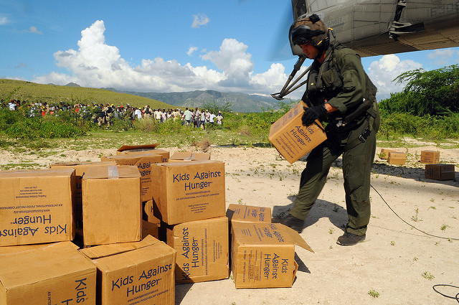
Feedback from Nov. 27
“Poverty.Inc was impactful and eye-opening.”
“Poverty.Inc was so powerful, I actually watched it twice.”
“I watched Poverty.Inc with my roommates. Everyone should see it.”
“I liked the discussion around volunTOURism.”
“The documentary was shocking to me… I thought we were helping poor people in Africa…but in fact, we’re destroying their ability to make a living.”
“The story about the local software developer losing the contract to the European developer made me mad!”
“Prof J’s personal examples informed me about the psychology of giving.”
“Interesting to see how good intentions can turn out so bad.”
“I ever thought about foreign aid that way.”
“Transportation– getting stuff there– is critical.”
“Most of our aid goes to the military.”
“Rip out your heart, rip out your wallet.”
”Find out what your beneficiaries want!”
“Making yourself feel good vs. doing good.”

Slide 3
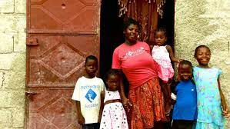
Poverty.Inc
“…what can you do individually to change the situation? The movie made me think that I don’t want to give my money to charities. What’s the solution?”
* Due diligence
* Volunteer
* Follow your passion, not the crowd
* Despair not! There are many agencies doing wonderful work. You can help make the world a better place. And make a good living by doing it.

Slide 4
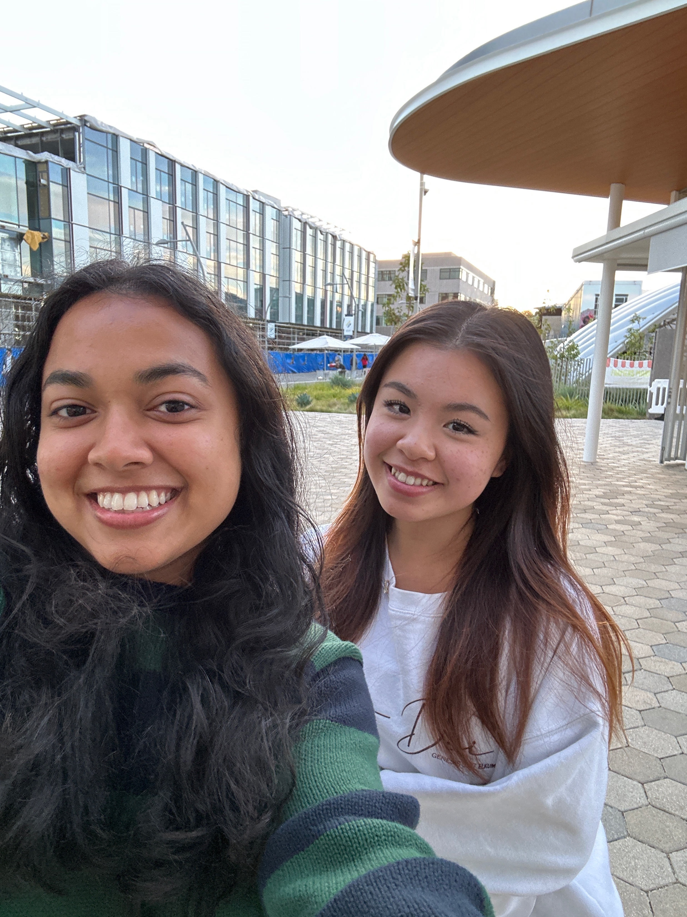
The “Social” in Social Entrepreneurship
Tanisha and Irene meet-up in Bird Rock

Slide 5

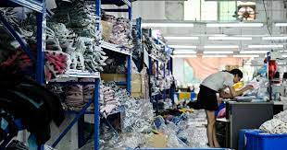
News of the Day WSJ: Shein Files to Launch Public Offer

Slide 6
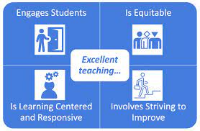
Student Evaluation of Teaching
SET surveys now open (Nov 27- Dec 9)
Available on Evaluations site
Changed from previous CAPES Survey
Holistic Teaching Evaluation Oversight Committee

Slide 7
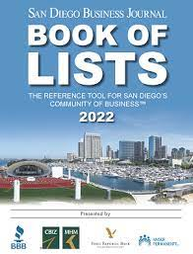
Return SDBJ Book of Lists

Slide 8

Networking Papers original guidance
A
Early start
Ambitious goal “Dream Big”
Overcome obstacles
Face-to-face interview
B
Same as above, but not a stretch
C
Success, but reliance on e-mail
#1 reason for lower grade…
procrastination

Slide 9
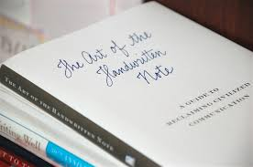
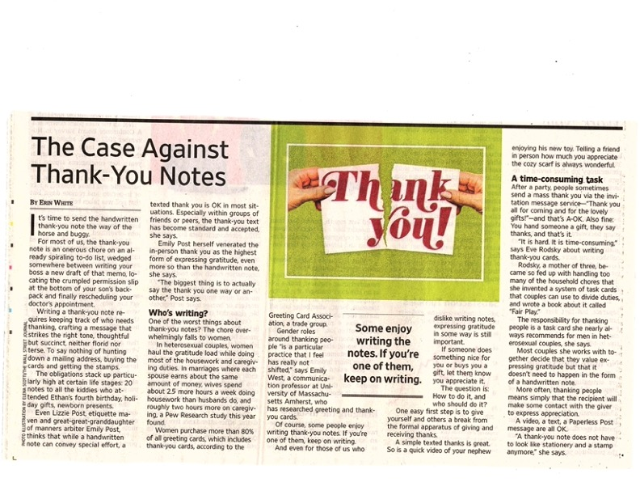
Thank you Note?
Painful experience for some.
Do it professionally or not all.
Discussion
Should it be required?
Make it a condition of A grade?
Look for WSJ Letters to Editor next week…

Slide 10
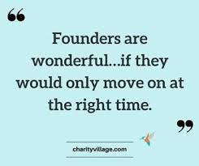
Next Class Monday, 13 March Crisis Communications Founders Disease
Debt and Disputes Cloud future of Iconic Church
SSIR Strong Boards
WSJ June 6, 2023 Companies That Embraced Social Issues

Slide 11
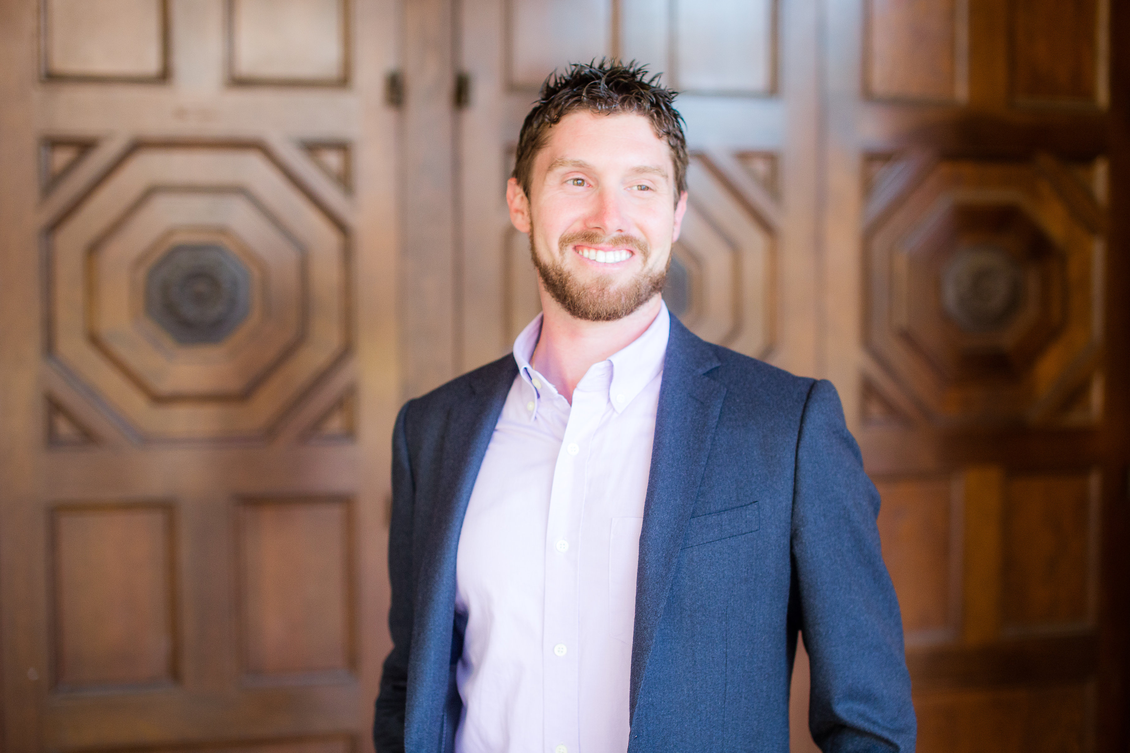

Guest Speaker: Neal Bloom Rising Tide Partners
Student Hosts:
Camden Greenwood, Hanna Medina, Vanessa Lu

Slide 12

Drawing for Girl Scout Cookies

Slide 13
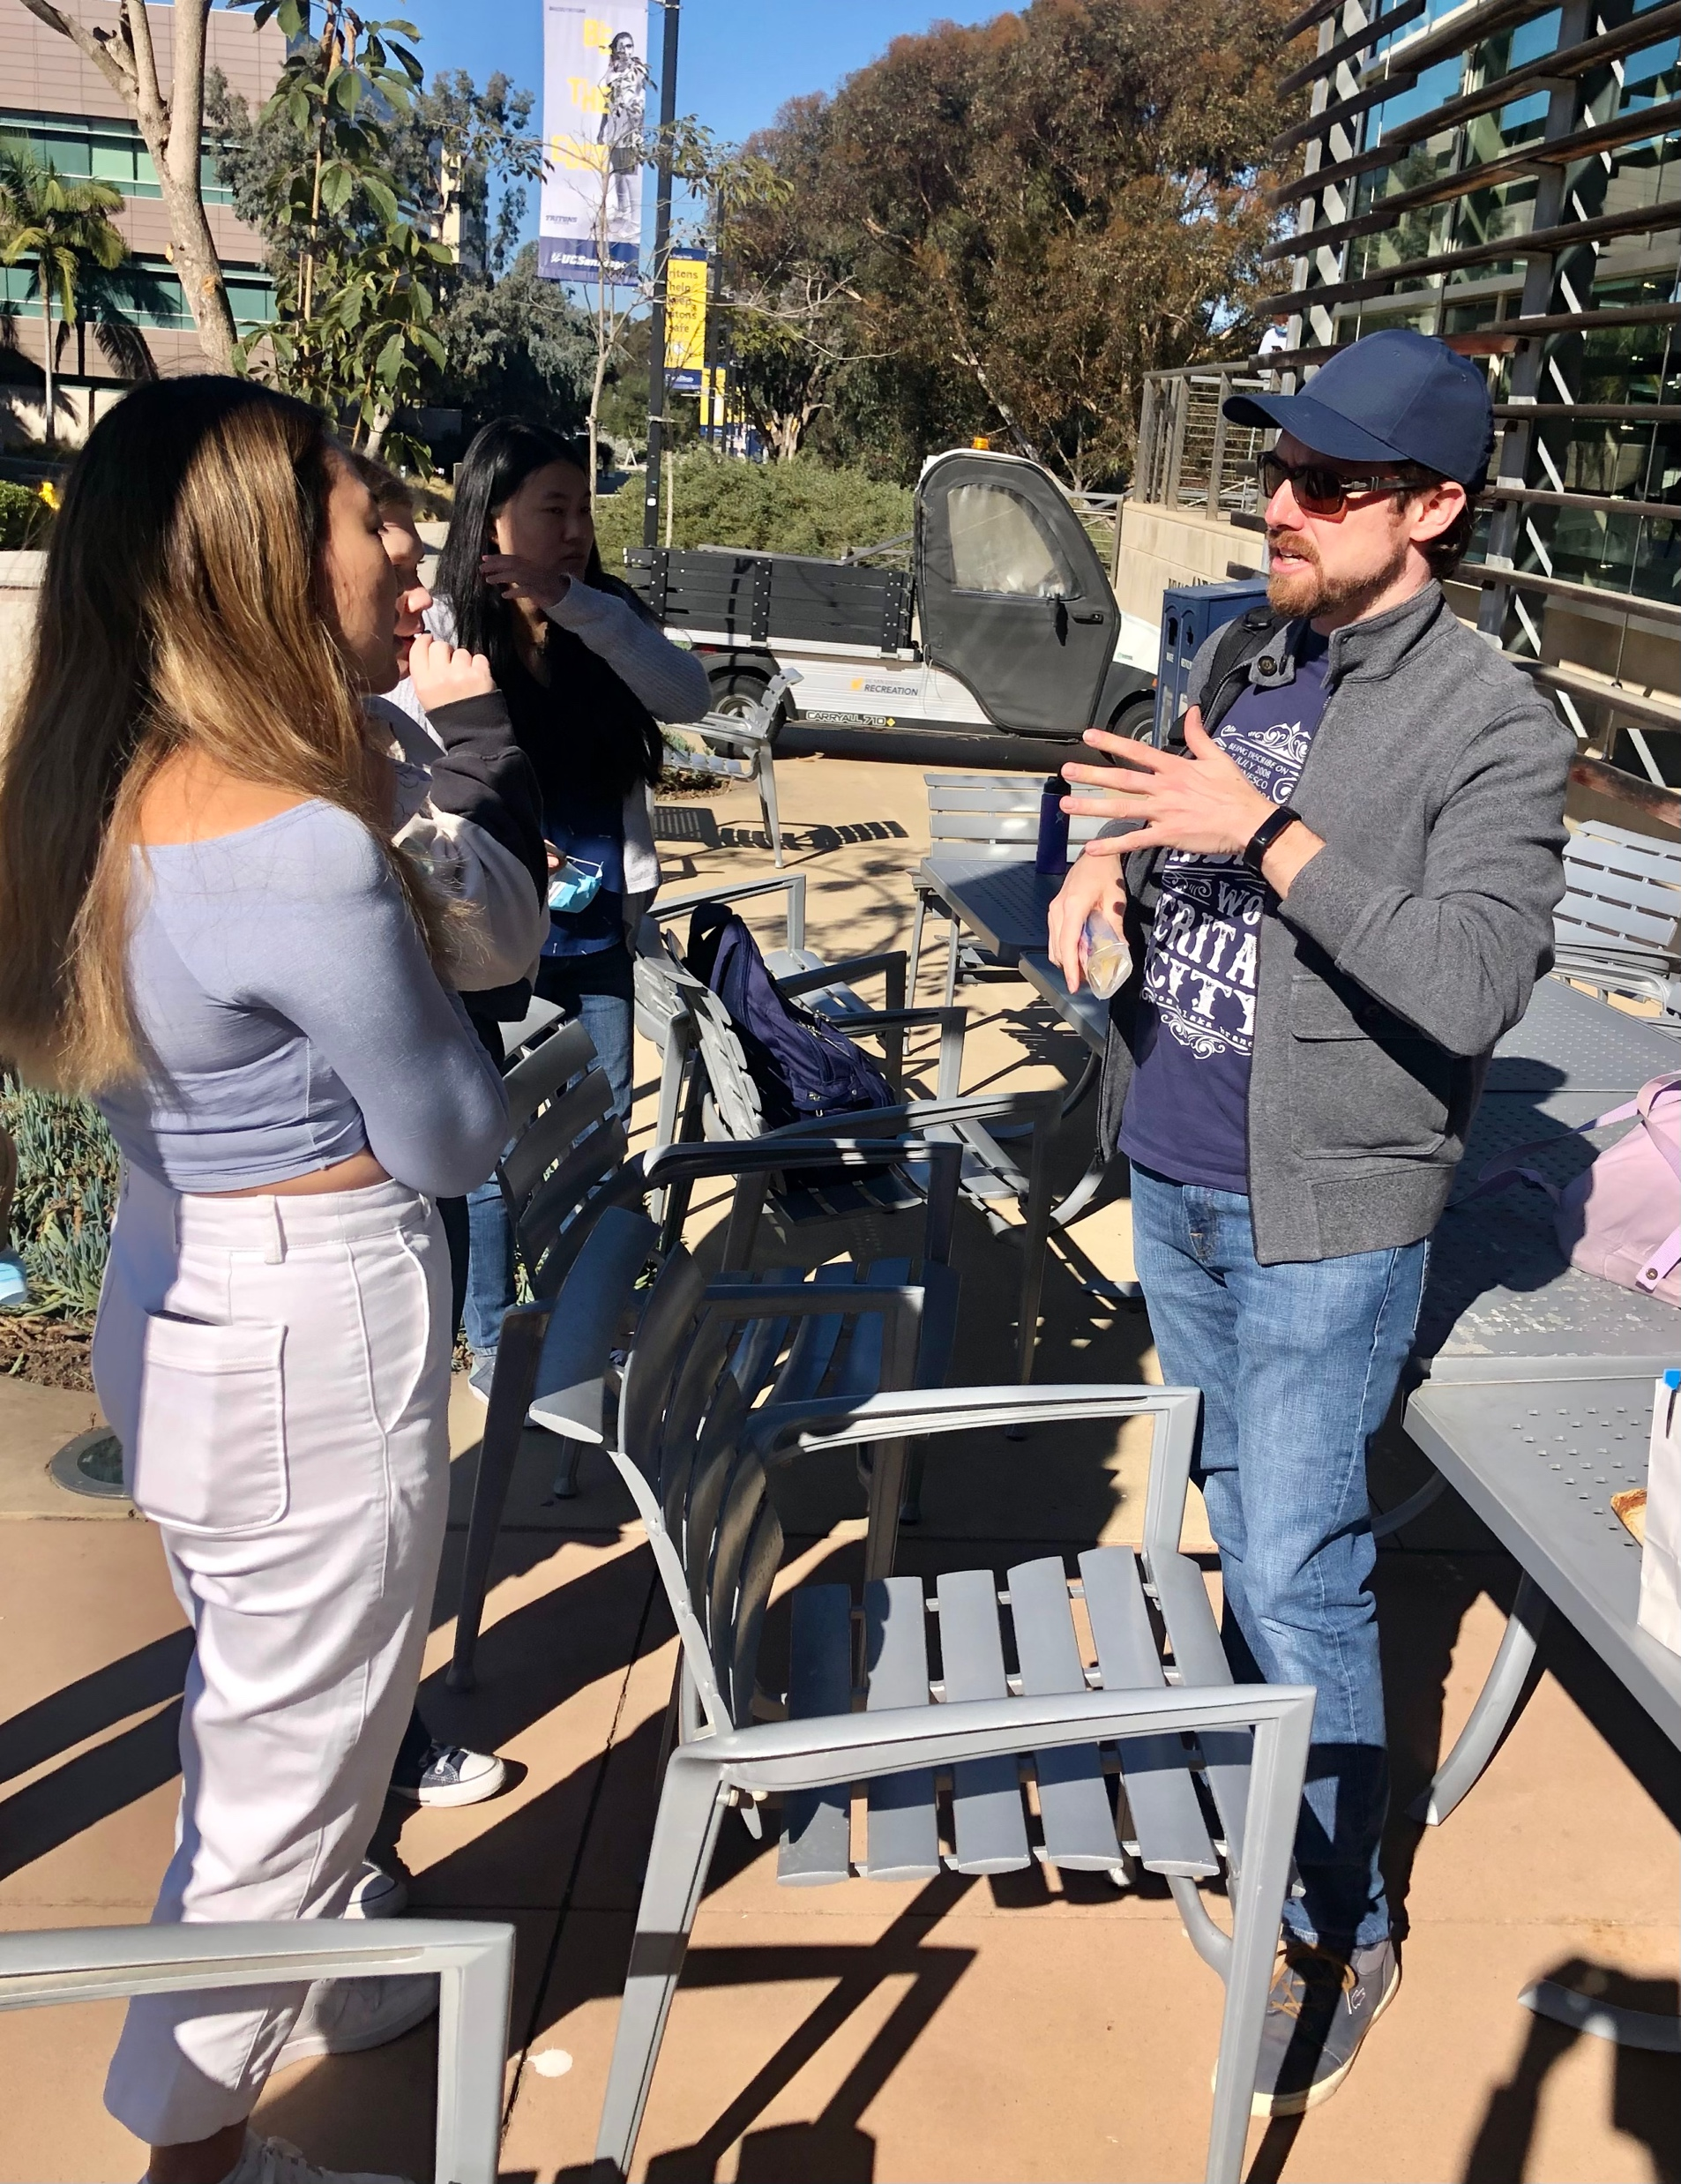
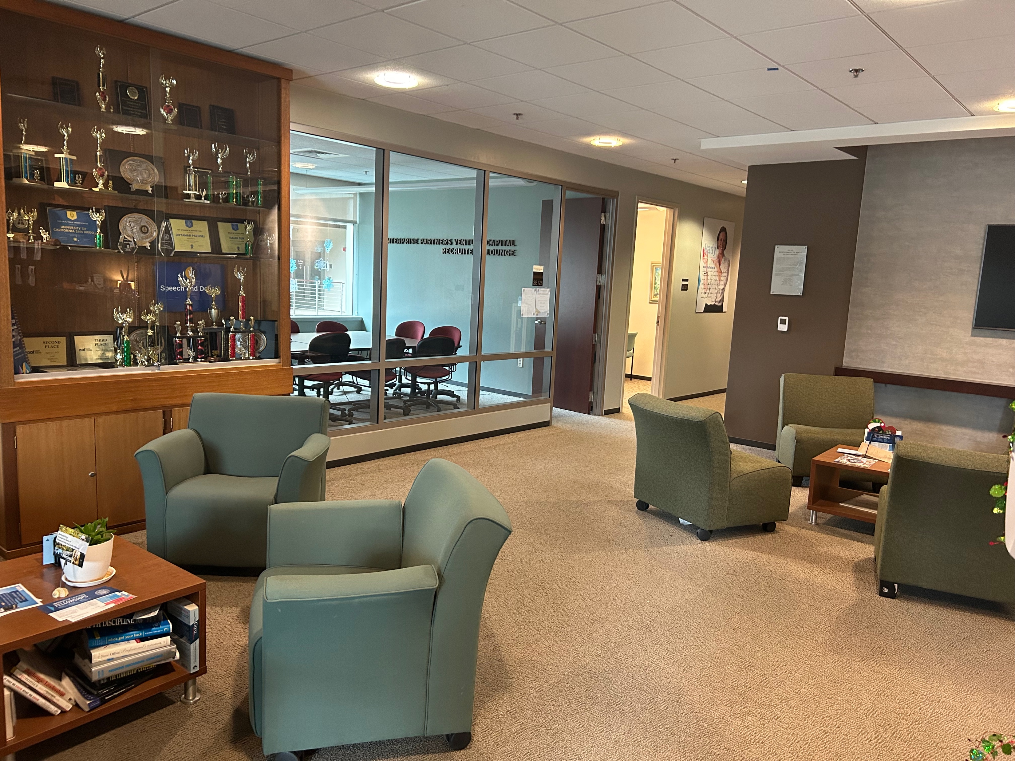
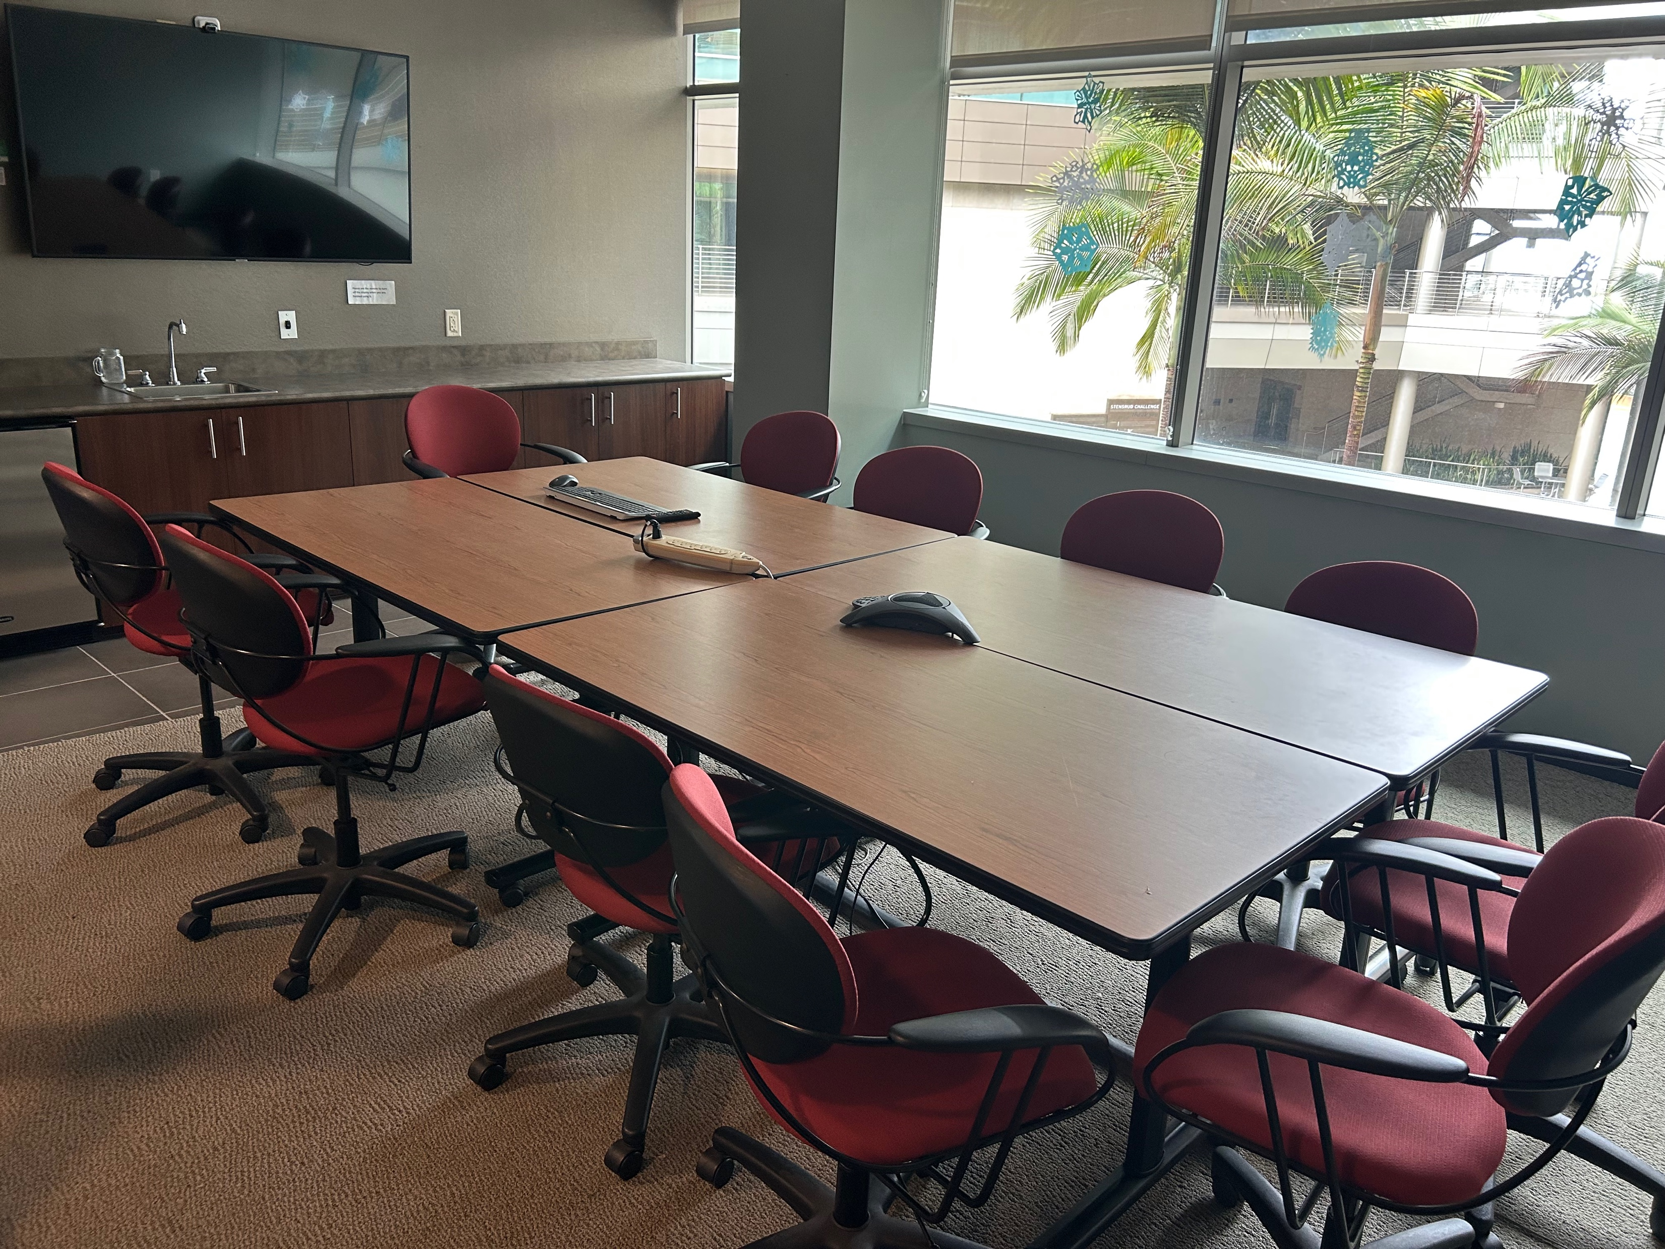
Join us for Brown Bag lunch

